Slide 1
designing for the Communications market
CONFIDENTIAL: All contents copyright of Illinois Tool Works, Inc. (ITW).
The ITW Photonics Group, Cal Sensors, ITW Linx, Lumex and Opto Diode logos are registered trademarks of ITW, Inc. Copyright © 2013, all rights reserved.

Slide 2

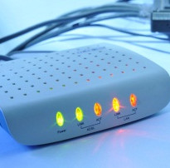
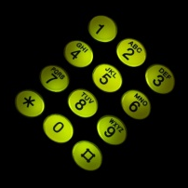

Product Components Ideal for Communications Applications
As the technology in the Communications market continues to evolve, so do the challenges that face design engineers. Lumex has been providing high-quality components for the Communications industry for over 30 years.
Some of Lumex’s focus niches within communications include:
industrial network routing equipment
network security equipment
graphic processing units
computer equipment
storage area network equipment
enterprise servers
business phone systems
microwave, optic and WiMAX equipment
video conferencing equipment
By partnering with a wide range of Communications companies over many decades, Lumex has become a leading player in bringing new optoelectronic and display technology specifically designed for this market.
Design Considerations for Communications Applications
Small Footprint
Long Lifetime
Extreme Temperatures
Low Power Consumption
Specific Wavelengths
Durability
Portability
CONFIDENTIAL: All contents copyright of Illinois Tool Works, Inc. (ITW).
The ITW Photonics Group, Cal Sensors, ITW Linx, Lumex and Opto Diode logos are registered trademarks of ITW, Inc. Copyright © 2013, all rights reserved.

Slide 3
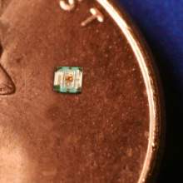
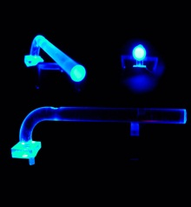
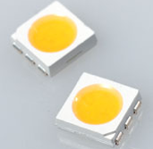
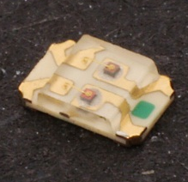
Product Components Ideal for the Communications Market
0404 Surface-Mount RGB LEDs
Full color surface-mount RGB LED
0404 Packaging – 1.0mm x 1.00mm x 0.25mm
Low current operation (30/40/20 mcd respectively for RGB @ 2mA)
Operating temperature range from -40˚C to +85˚C
Lumex Product Families
High Power LEDs
Ultraviolet LEDs
Thru-Hole & SMD LEDs
Panel & PCB Indicators
LED Displays
LED Arrays
Light Pipes
Infrared Devices
Monochromatic & Color LCDs
Light Pipes (LPF series)
Ray Trace Software with Precise 3D CAD/CAM Models
Right angle and vertical standard packaging solutions
Accommodates all colors
Custom solutions accommodating varying height & widths available with minimal tooling
PLCC-6, 5050 Package
State-of-the-art high brightness chip technology
3 Dice per LED package
Lead frame / lens casting reliability
0805 Package, Bi-Color SMD LEDs
State-of-the-art high brightness chip technology
Custom solutions available
Easy-to-solder, Gold finish
Lens casting reliability
Choice of LED colors
CONFIDENTIAL: All contents copyright of Illinois Tool Works, Inc. (ITW).
The ITW Photonics Group, Cal Sensors, ITW Linx, Lumex and Opto Diode logos are registered trademarks of ITW, Inc. Copyright © 2012, all rights reserved.
CONFIDENTIAL: All contents copyright of Illinois Tool Works, Inc. (ITW).
The ITW Photonics Group, Cal Sensors, ITW Linx, Lumex and Opto Diode logos are registered trademarks of ITW, Inc. Copyright © 2013, all rights reserved.

Slide 4
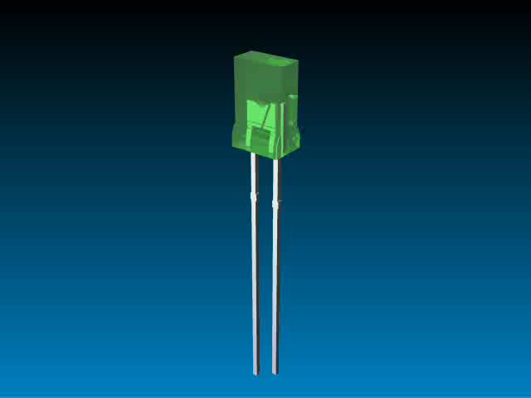
Multiple Technologies…
One Product Solution
In today’s competitive marketplace, many engineers are finding that many standard technologies do not meet all of their needs.
More and more, design engineers are recognizing that an application-specific solution will offer the best result for more complex design needs.
Lumex has proven success at translating initial design concepts and turning them into reality.
Whether addressing a current
design challenge or integrating
multiple components into one
sub-assembly, Lumex will work
with you from initial prototype
through final production.
Lumexs offer experience,
quality and innovative originality
to help bring products to market
faster and help provide that
competitive edge.
Benefits of
Value Add Solutions
Focus on application needs
Stand out from competition
Enhanced reliability
Speed time to market
Reduced labor costs
Faster ROI
Full plug ‘n play solution
Engineering know-how that acts as an extension of your own team
CONFIDENTIAL: All contents copyright of Illinois Tool Works, Inc. (ITW).
The ITW Photonics Group, Cal Sensors, ITW Linx, Lumex and Opto Diode logos are registered trademarks of ITW, Inc. Copyright © 2013, all rights reserved.

